Slide 1
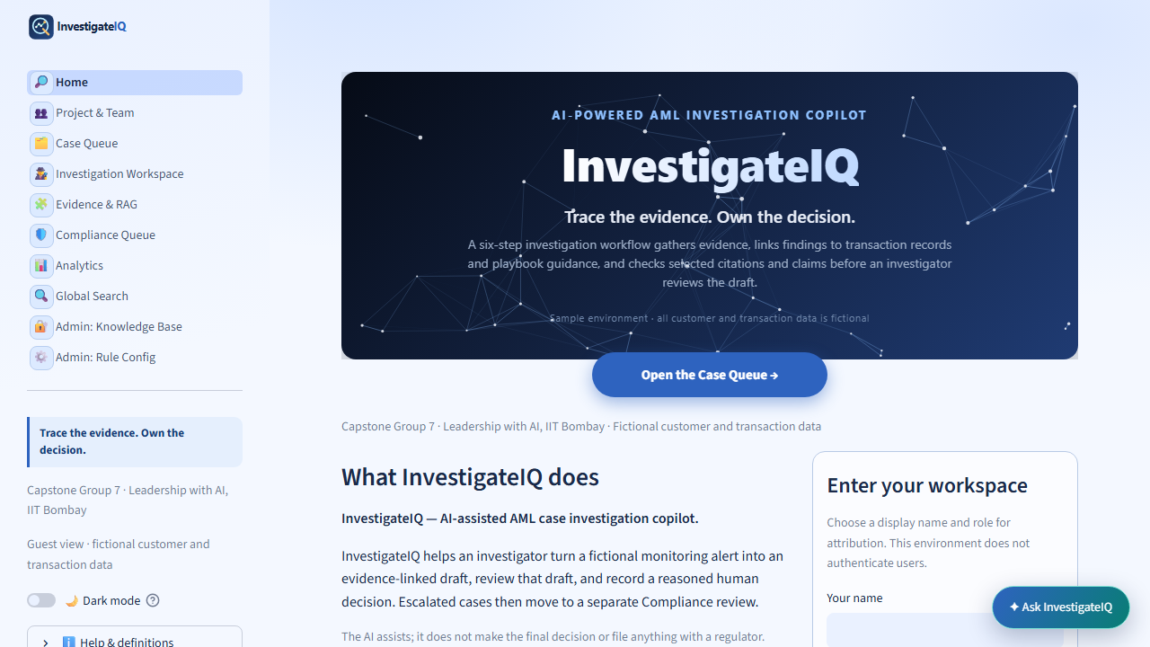
CAPSTONE GROUP 7
InvestigateIQ
Trace the evidence. Own the decision.
A transparent, AI-assisted workflow for fictional AML case investigations.
Single presenter — to be confirmed
7:10 slides • 4:50 live demo • 3:00 panel Q&A
InvestigateIQ | Capstone Group 7 | 1 of 9
Fictional AML investigation learning environment
Notes:
The assigned presenter opens in 25 seconds. State that this is a fictional AML learning product and that the session uses 7 minutes 10 seconds of slides, 4 minutes 50 seconds of live demo, and 3 minutes of Q&A.

Slide 2
PROGRAM STATEMENT
What this capstone will deliver—and what it will not
Design and demonstrate a fictional AML review workflow where every report claim is traceable to supplied material, limitations stay visible, and workflow actions remain named human decisions.
Track
Measures
Non-goals
Blueprint + Prototype + Detailed code + Final results
Traceability, visible gaps, clear states, and required rationale
No real data, autonomous decision, legal conclusion, or external filing
Team: Rahul Chainani · Pankaj Bharsakale · Lakshmi Dudgikar · Rahul Sharma · Laxman Singh · Soumya · Sweta Singh
One team member will present the full session; the presenter will be confirmed tomorrow.
InvestigateIQ | Capstone Group 7 | 2 of 9
Fictional AML investigation learning environment
Notes:
The assigned presenter uses 35 seconds. Read the statement, selected track, and non-goals. Introduce the team in the displayed order and state that one presenter will handle the full session.

Slide 3
THE PRODUCT
From a stored alert to an accountable human action
1
2
3
4
5
Queue
Workspace
Evidence
Decision
Compliance
Find and filter the fictional alert
Build or replay the review
Read exact records and chunks
Record a required rationale
Perform a second human review
The application supports investigation. It never closes, escalates, refers, or files an action automatically.
InvestigateIQ | Capstone Group 7 | 3 of 9
Fictional AML investigation learning environment
Notes:
The assigned presenter uses 30 seconds. Move left to right through the flow. Emphasize human decision ownership and separate Compliance review.

Slide 4
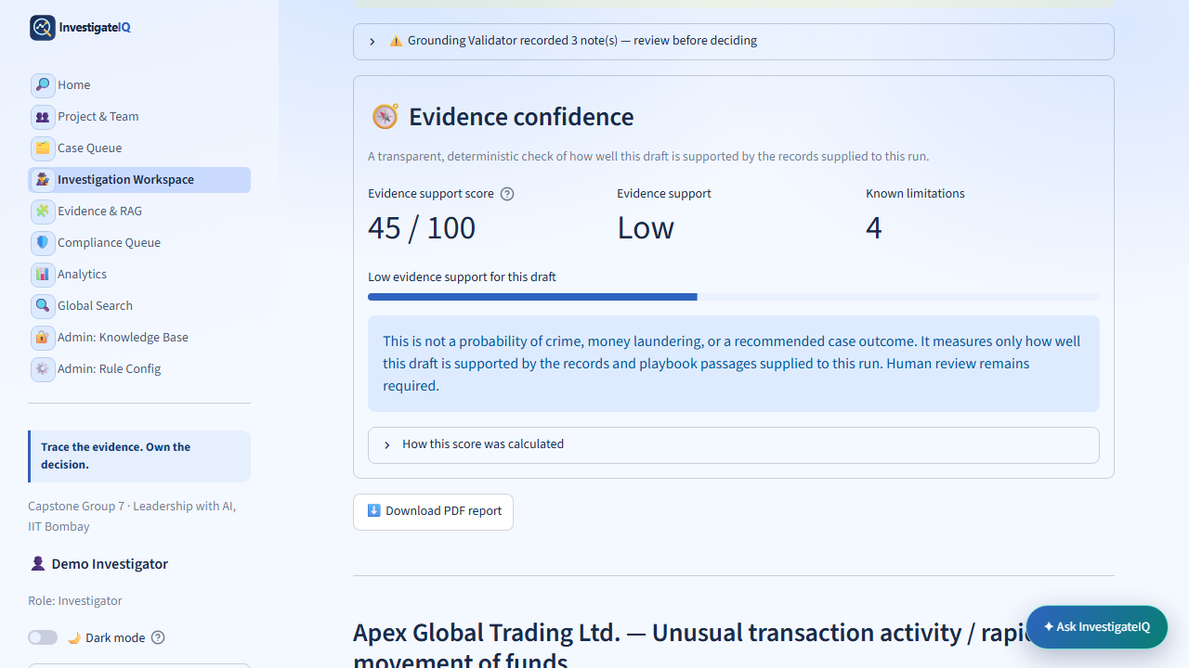
RESPONSIBLE AI
Evidence confidence exposes support gaps—it does not predict wrongdoing
Coverage
Supplied records and guidance that support the draft
Limitations
Known missing or unresolved evidence
Boundary
Not a crime, legality, or outcome probability
InvestigateIQ | Capstone Group 7 | 4 of 9
Fictional AML investigation learning environment
Notes:
The assigned presenter uses 40 seconds. Define evidence confidence as deterministic support coverage. It is not a risk score, probability of crime, legality assessment, or recommended outcome.

Slide 5
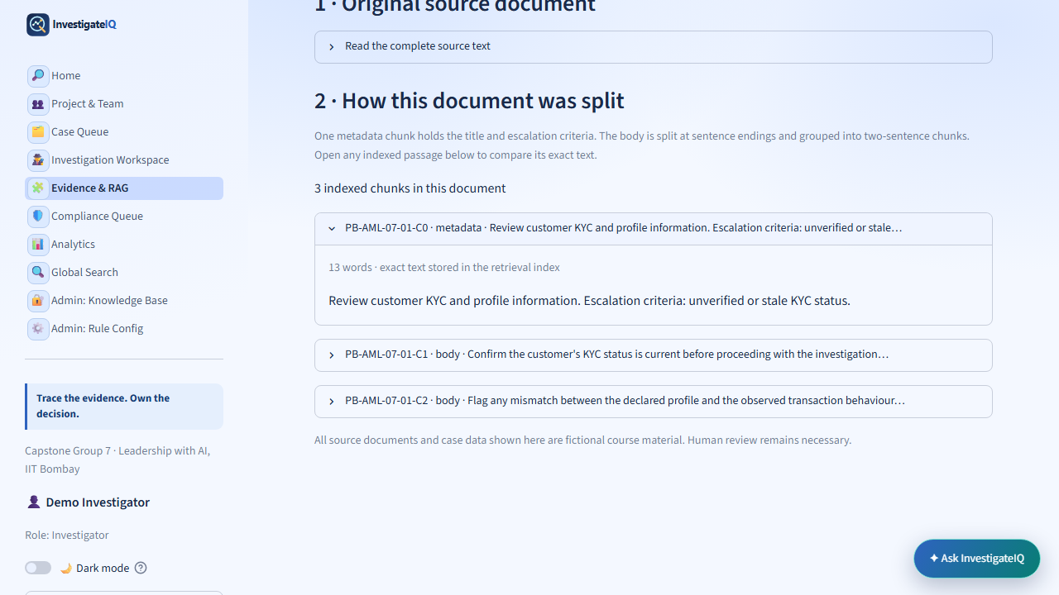
OKF, CHUNKS, AND RAG
The coding logic keeps the source trail inspectable
1
OKF source
ID, scenario, title, criteria, body
2
Chunk builder
C0 metadata + two-sentence body chunks
3
FTS5 + BM25
Local keyword match and rank
4
RAG context
Retrieved IDs produce a cited, reviewable answer
OKF source → chunk builder → FTS5/BM25 → retrieved IDs → cited response
InvestigateIQ | Capstone Group 7 | 5 of 9
Fictional AML investigation learning environment
Notes:
The assigned presenter uses 55 seconds. OKF is Open Knowledge Format: a source record with stable metadata and body text. Explain C0 metadata and two-sentence chunks, then local SQLite FTS5 keyword search and BM25 ranking. Say retrieval finds text; it does not prove truth.

Slide 6
TECHNICAL DESIGN
Inspectable page logic instead of hidden autonomous behavior
Streamlit router
Case scope
SQLite
Navigation routes to page modules
Session keeps the active fictional case
Alerts, sources, chunks, audit events
Checks
Audit state
Release
Citations and deterministic confidence
Named rationale becomes append-only record
Local validation → GitHub main → Railway check
route → active case → SQLite / FTS5 → cited report → append-only human audit event
InvestigateIQ | Capstone Group 7 | 6 of 9
Fictional AML investigation learning environment
Notes:
The assigned presenter uses 55 seconds. Give the code flow: Streamlit routes pages, session state holds an active case, SQLite stores fictional data, FTS5/BM25 returns chunks, checks constrain citations and confidence, and a human rationale creates an append-only audit event.

Slide 7
LIVE DEMONSTRATION FLOW
One case, read-only navigation, no decision submitted
0:00–0:25
Case Queue
Filter or identify one open case; distinguish Status from Action.
0:25–1:10
Workspace
Open it; show report mode, validator, and evidence-confidence boundary.
1:10–2:10
Evidence & RAG
Open Source & chunks; trace one chunk and run one keyword search.
2:10–2:55
Copilot
Ask one bounded case question; point to citations and limitations.
2:55–3:40
Human / Compliance
Show required rationale and recorded-state behavior without submitting.
3:40–4:50
Analytics / Search
Read one chart axis; use search to return to related case context.
InvestigateIQ | Capstone Group 7 | 7 of 9
Fictional AML investigation learning environment
Notes:
The assigned presenter uses 45 seconds to explain the demo plan, then performs it. Use one case. Navigate and expand only. Do not submit an investigator or Compliance action, create intake data, or reveal an Admin passcode. Speak only about what is under the pointer.

Slide 8
VALUE REALIZATION AND ROADMAP
Measure the benefit before claiming ROI
Efficiency
Verified minutes saved locating case records and source passages
Rework
Avoided evidence requests and Compliance returns
Audit readiness
Time to reconstruct evidence, rationale, and outcome
Safety
Unsupported claims, broken citations, unclear states found in review
ROI % = (verified annual benefit − implementation and run cost) ÷ implementation and run cost × 100
Roadmap: test fixtures + citation evaluation → authentication + lineage versioning → governed ingestion + approved integrations
Planning model only: calculate ROI only after a baseline, approved cost boundary, and verified pilot outcomes.
InvestigateIQ | Capstone Group 7 | 8 of 9
Fictional AML investigation learning environment
Notes:
The assigned presenter uses 50 seconds. Say this is an ROI measurement framework, not an invented financial result. Name the four value levers and future sequence. A real ROI needs a baseline, approved costs, and verified pilot results.

Slide 9
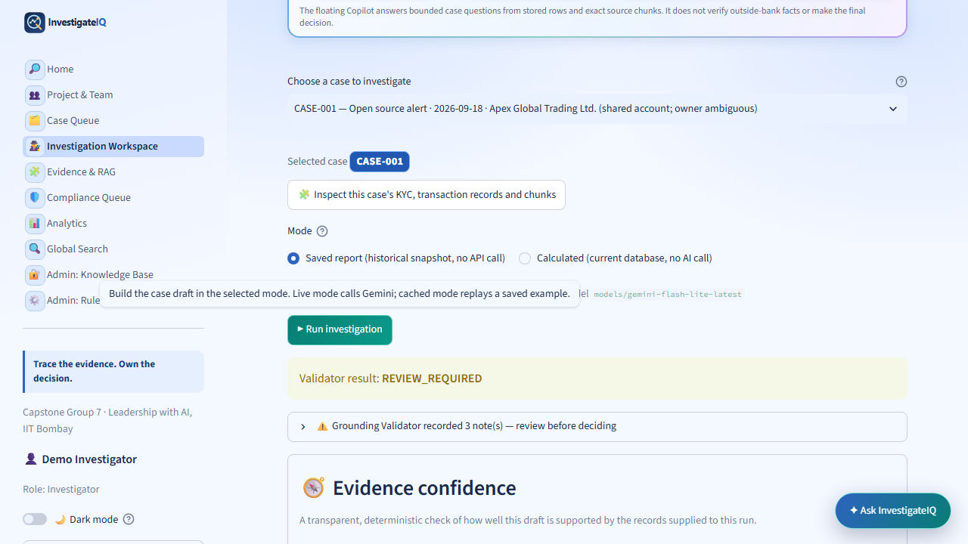
CLOSING
Trace the evidence. Own the decision.
Traceable evidence
Records, chunks, citations, and visible gaps
Responsible AI
Confidence limitations, not automated judgement
Human accountability
Named rationale and separate Compliance review
We will now show the same path live, using one fictional case.
InvestigateIQ | Capstone Group 7 | 9 of 9
Fictional AML investigation learning environment
Notes:
The assigned presenter uses 30 seconds. Recap the three pillars, then begin the live demo exactly as planned. Reserve the final 3 minutes for panel Q&A; the same presenter remains the sole speaker throughout.

